Slide 1
Next Meeting: November 8, 2019 Wichita, Kansas

Slide 2
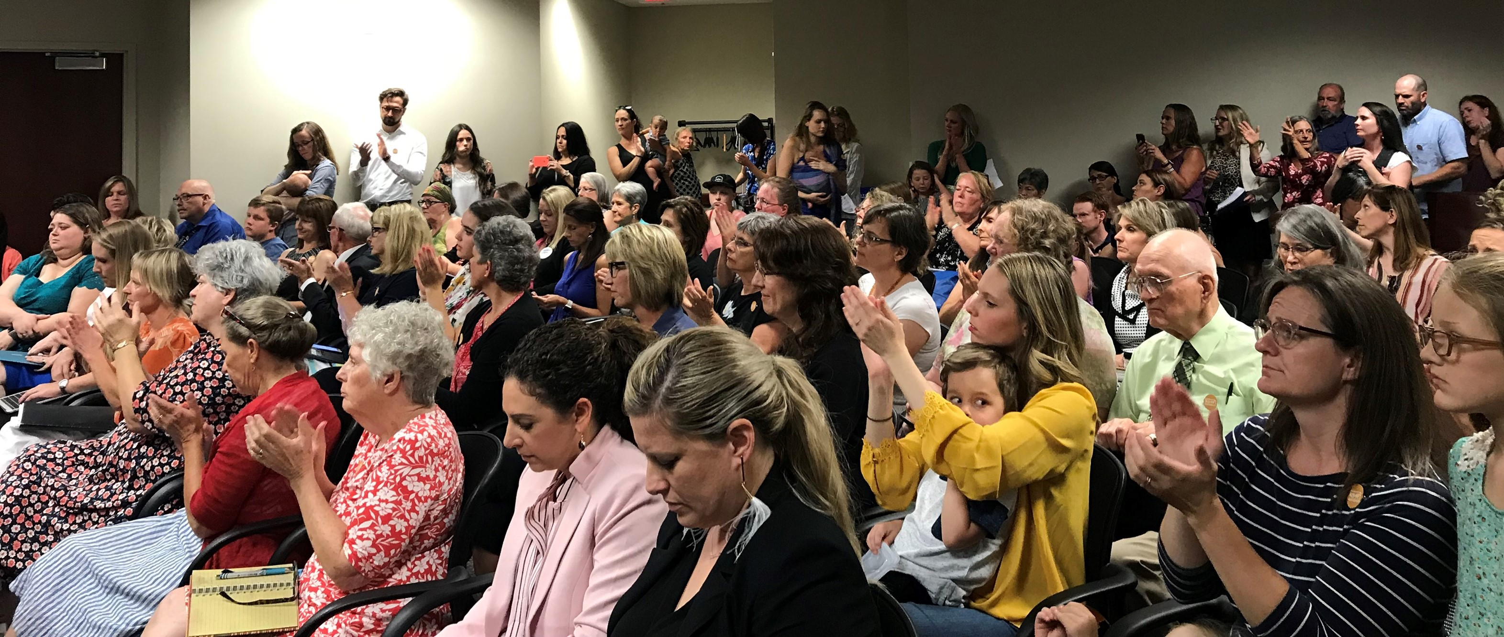
Vaccine Hearing – June 27, 2019

Slide 3
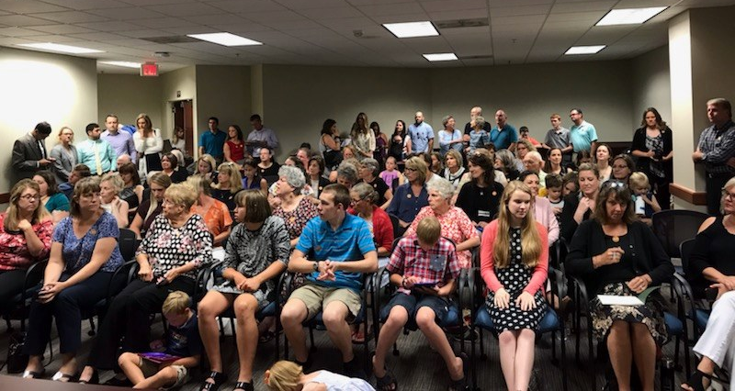
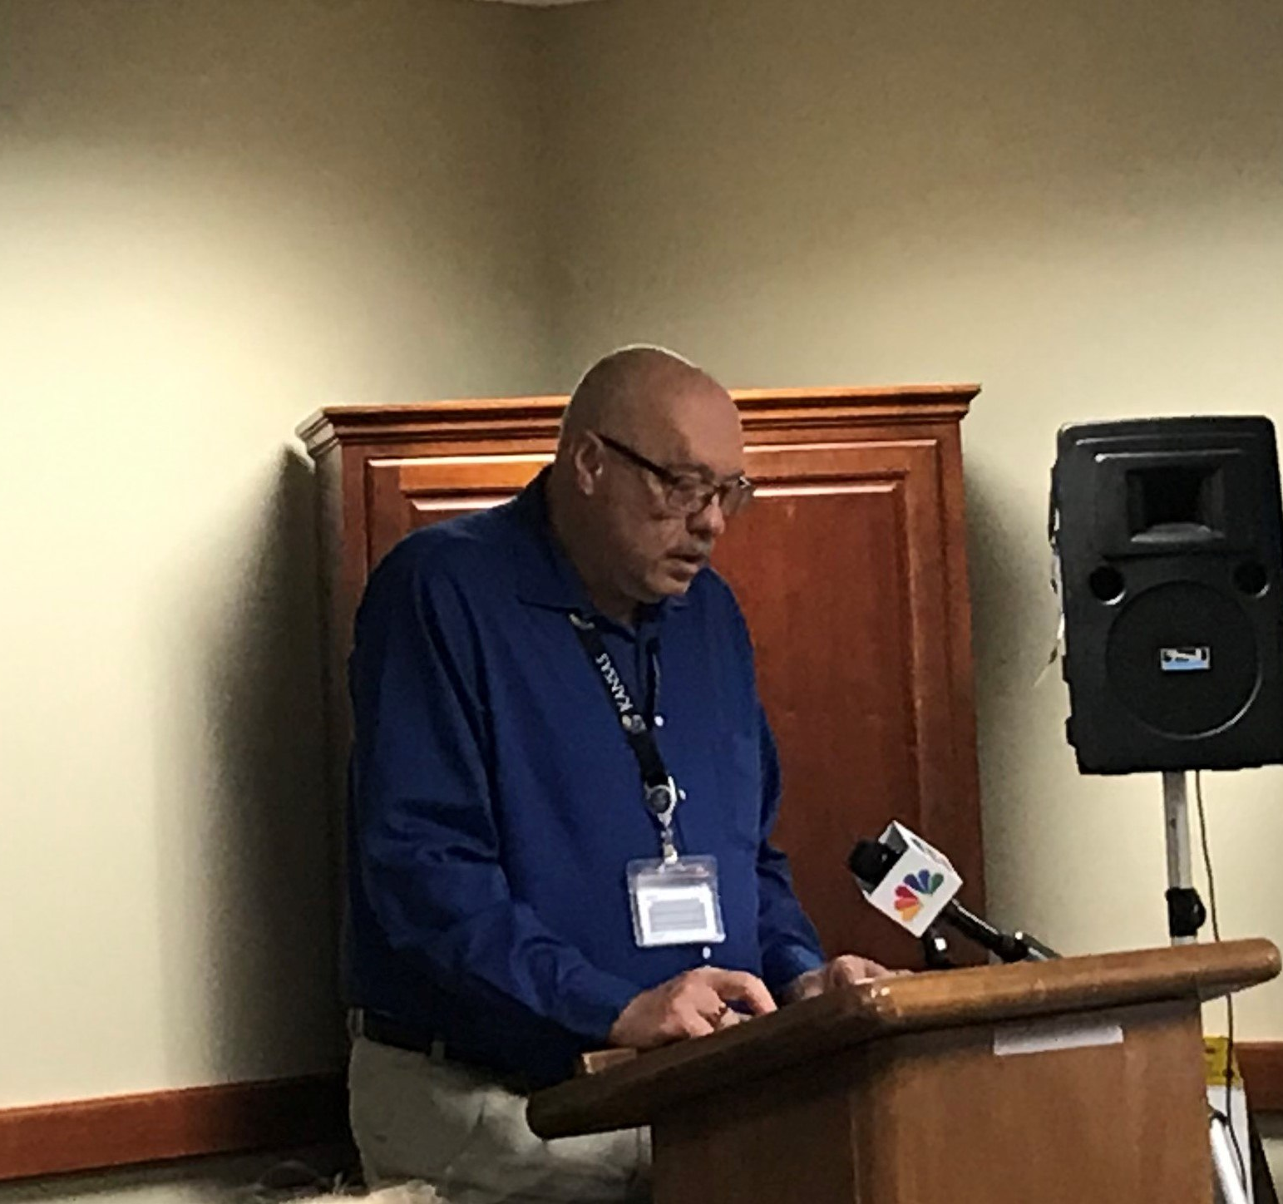
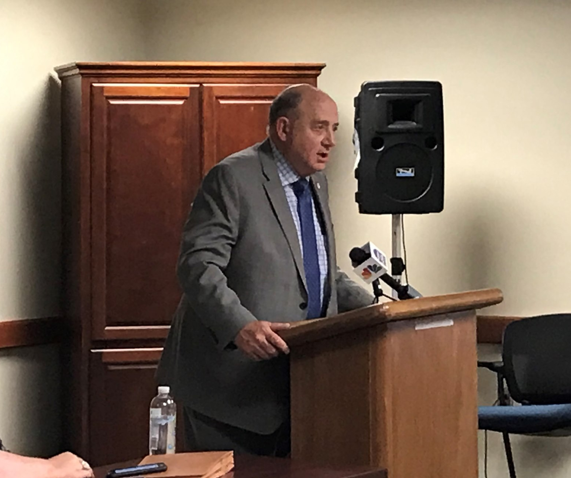
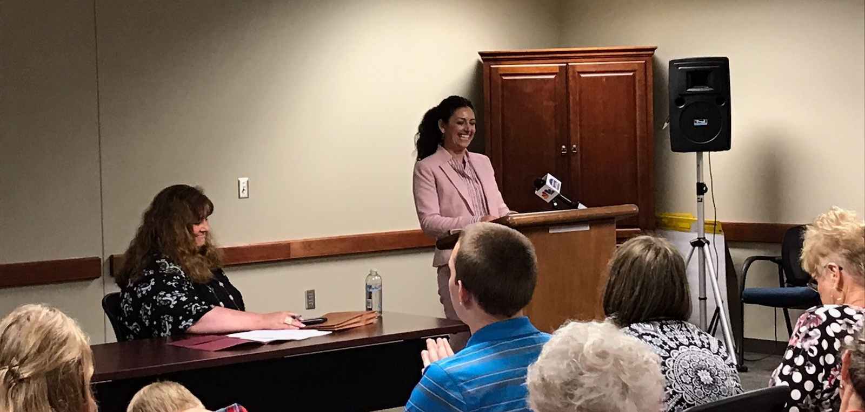
Vaccine Hearing – June 27, 2019

Slide 4
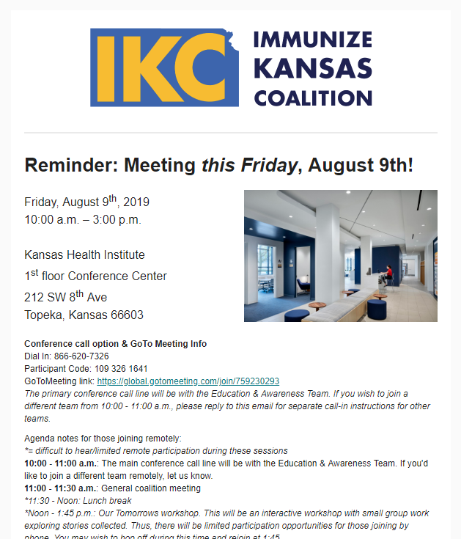
IKC is sending updates from a new
email address!
Be sure to whitelist us.
immkscoalition@gmail.com

Slide 5
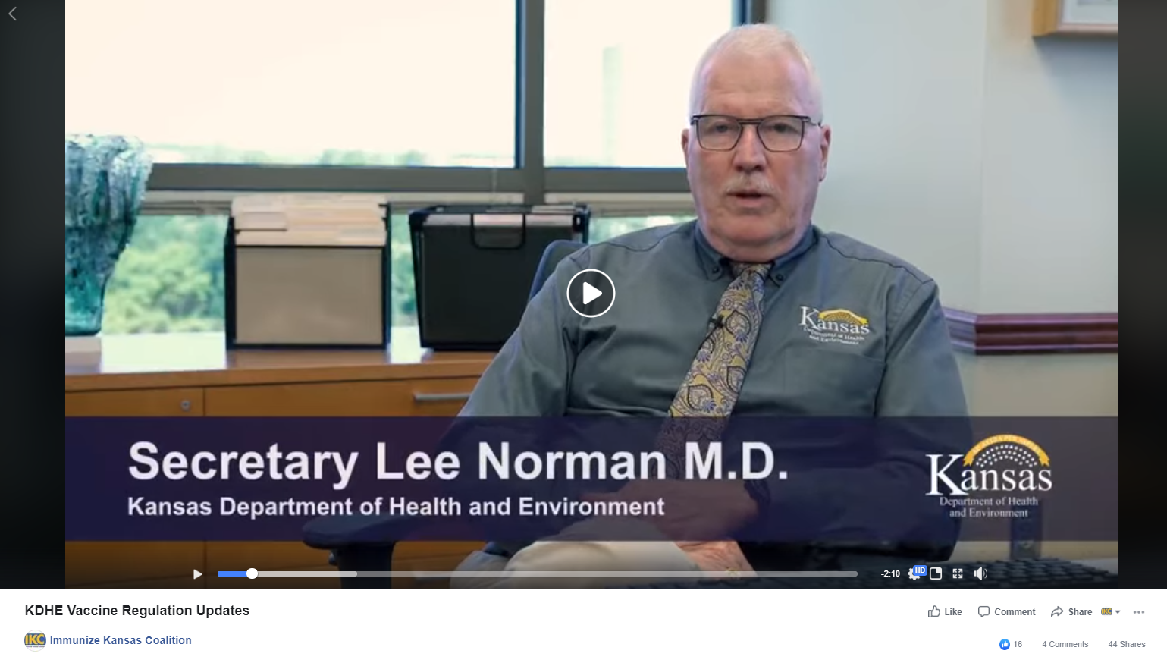
Recent Popular Facebook Posts
Video: KDHE Vaccine Regulation Updates Reached 3,678 people
Back to School Vaccine Posts
Reached 4,583 people

Slide 6
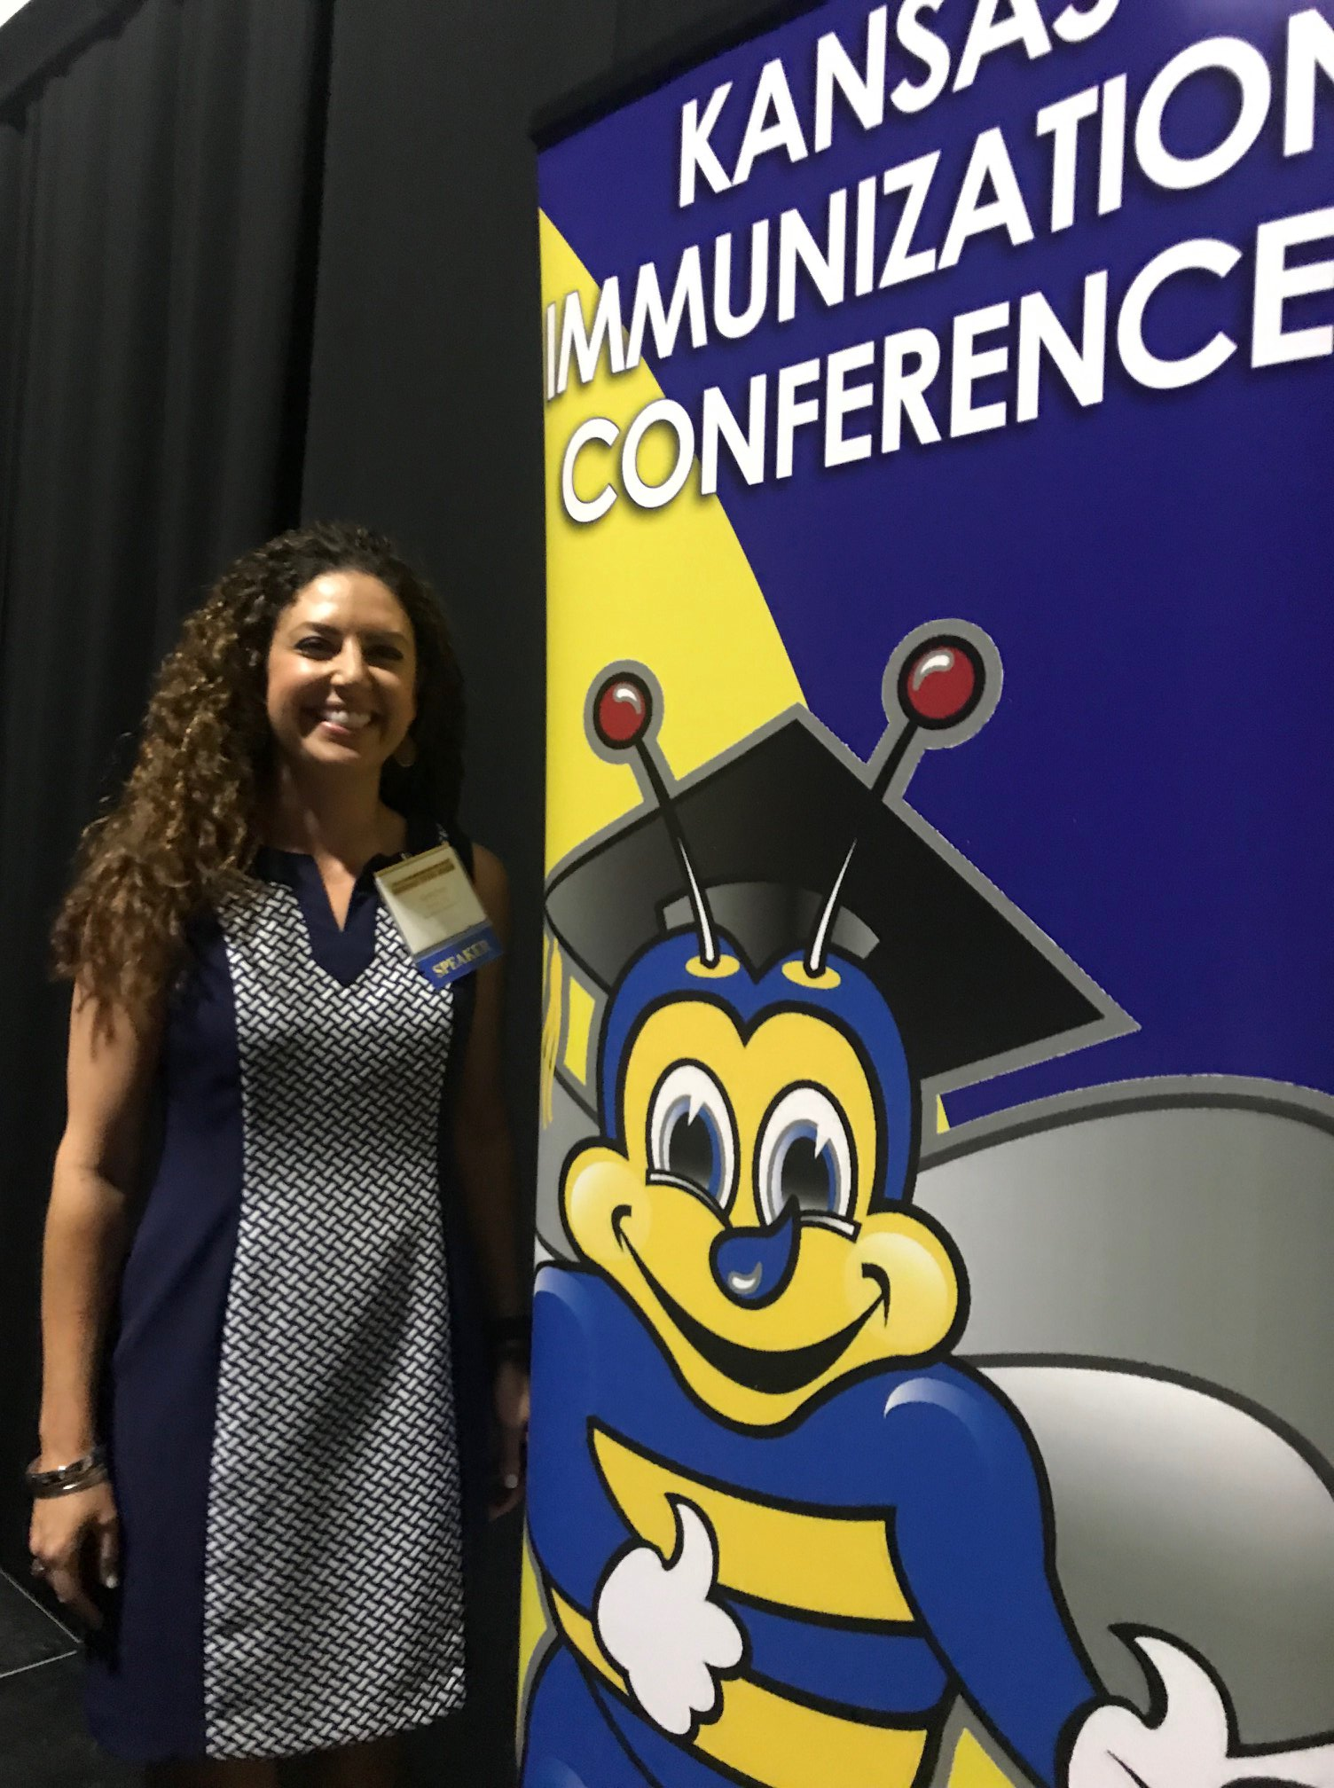
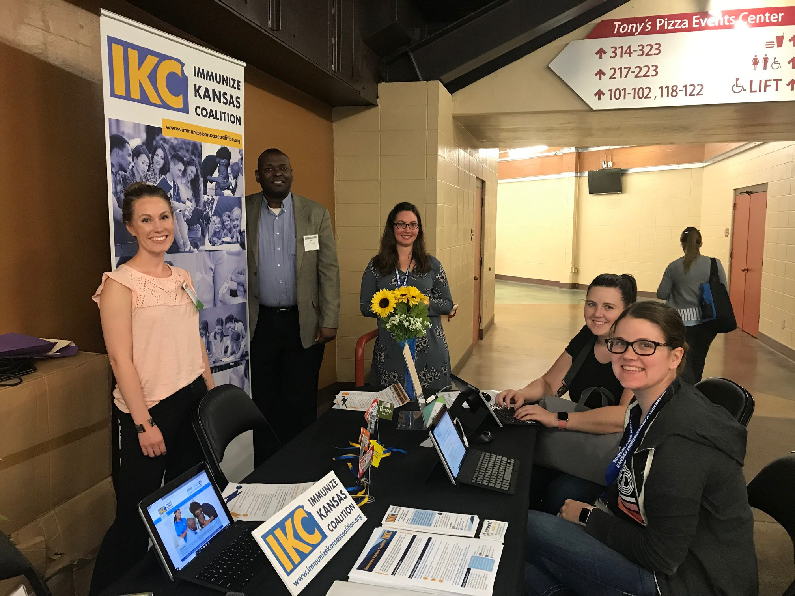
Kansas Immunization Conference – June 12 & 13

Slide 7
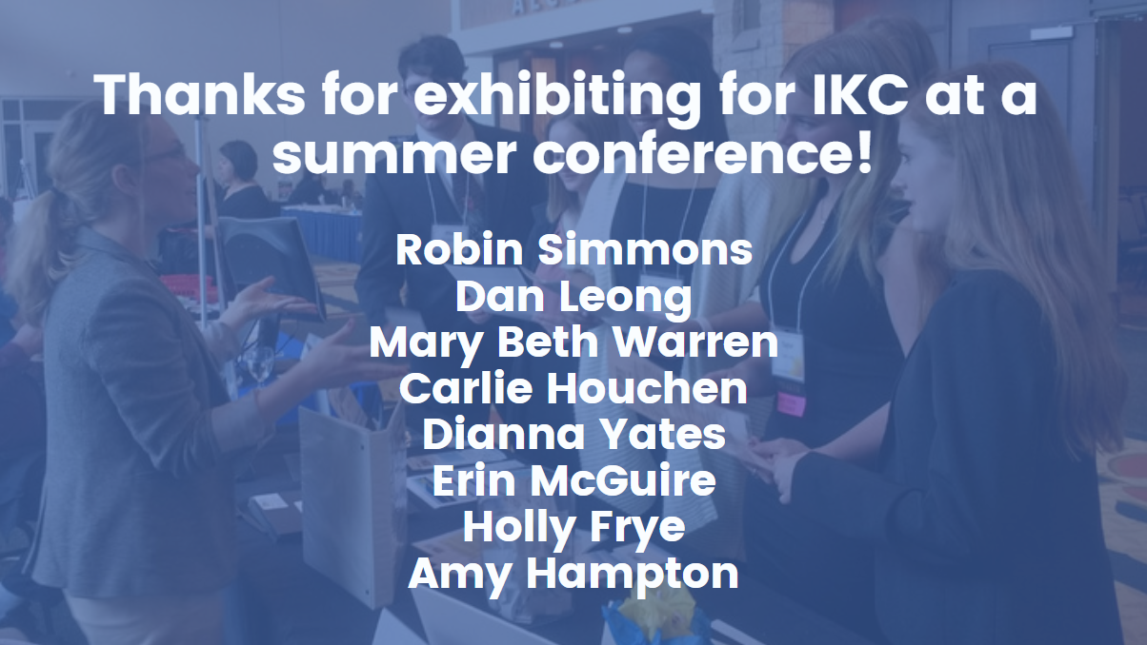
Thanks for exhibiting for IKC at a summer conference!
Robin Simmons
Dan Leong
Mary Beth Warren
Carlie Houchen
Dianna Yates
Erin McGuire
Holly Frye
Amy Hampton

Slide 8
In July alone, IKC’s Facebook reached over 11,000 people!

Slide 9
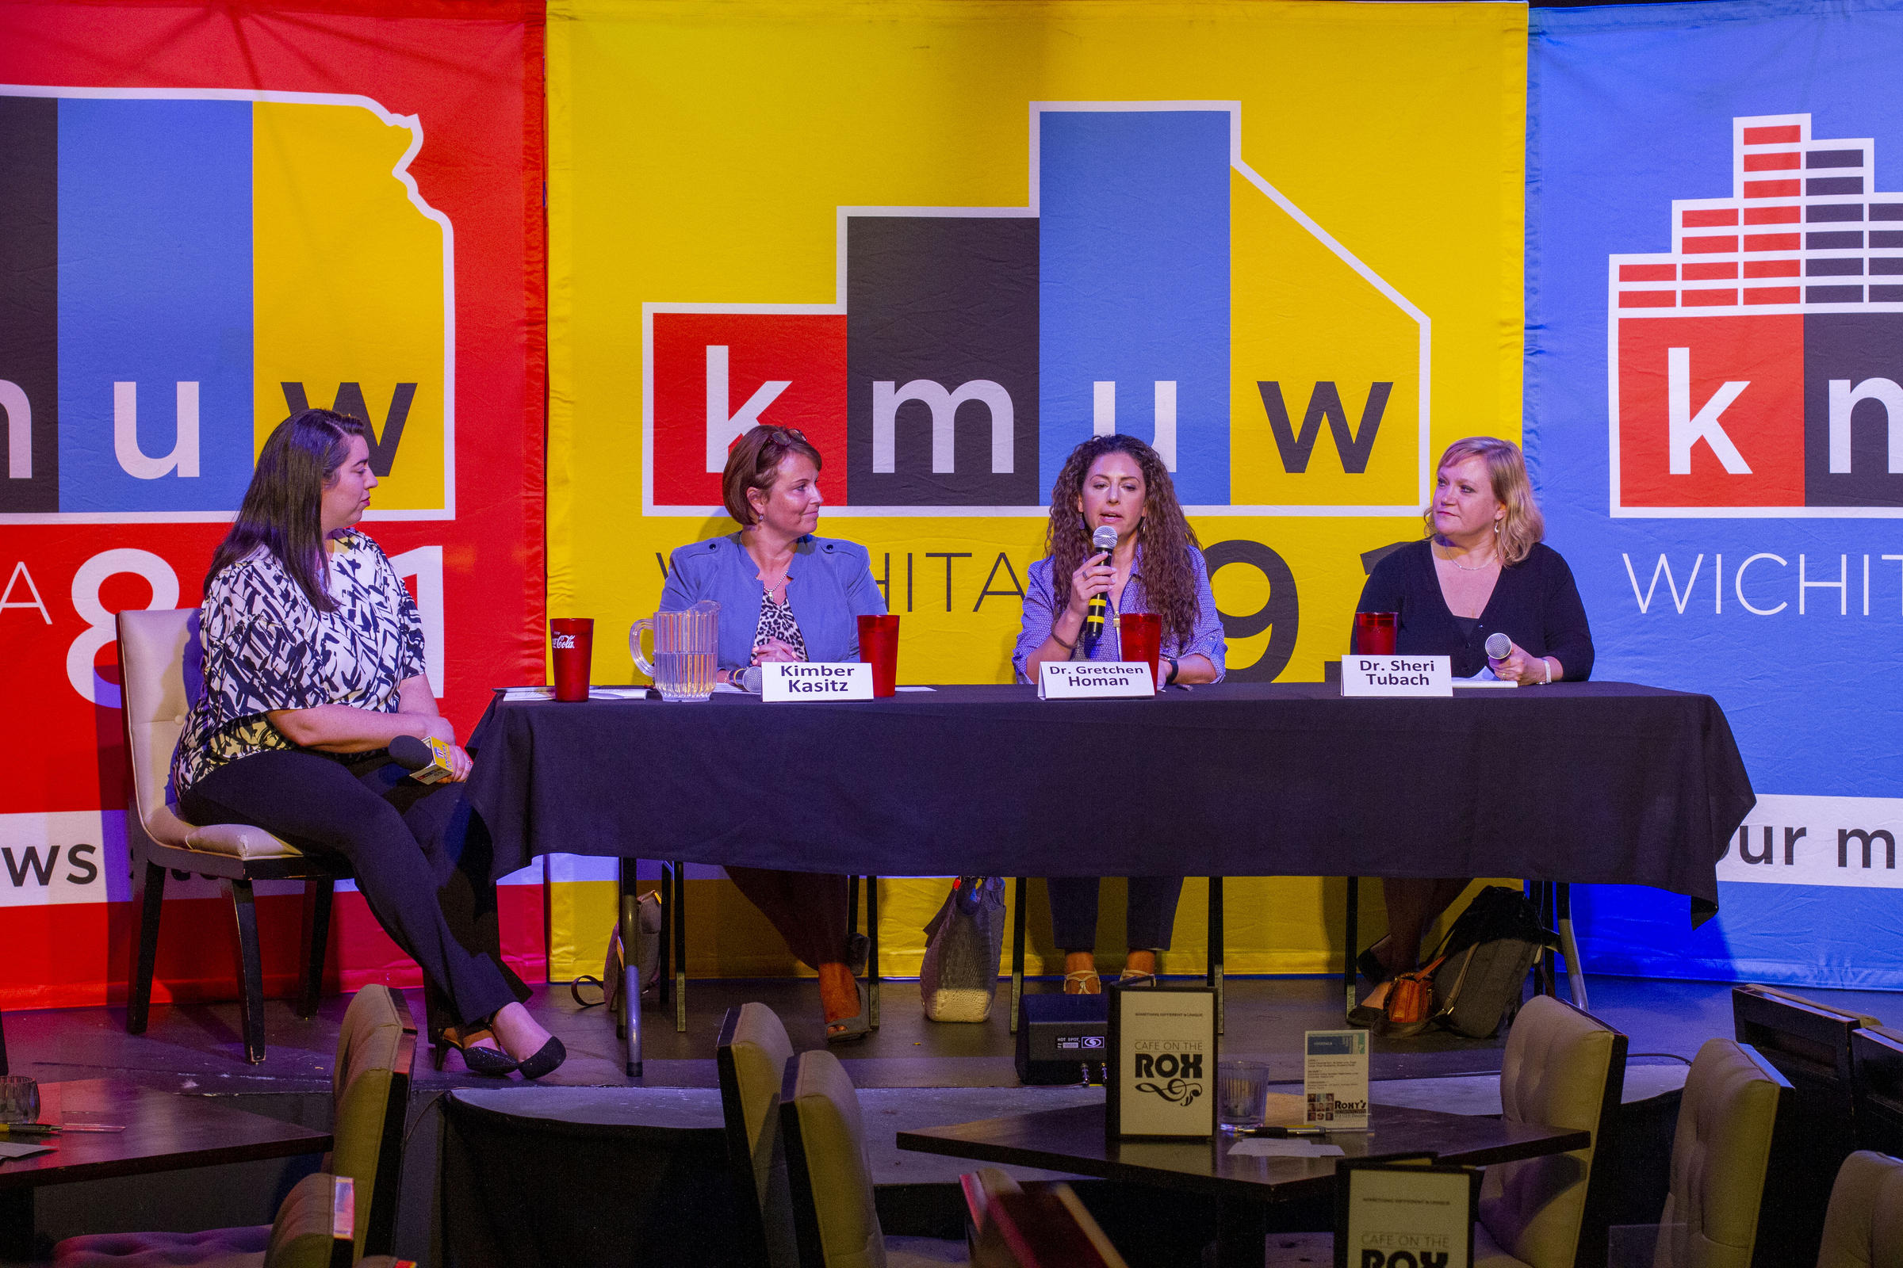
Kimber Kasitz,
Dr. Gretchen Homan
Sheri Tubach
July 9, 2019
Notes:
https://www.kmuw.org/post/democracy-tap-vaccinations

Slide 10
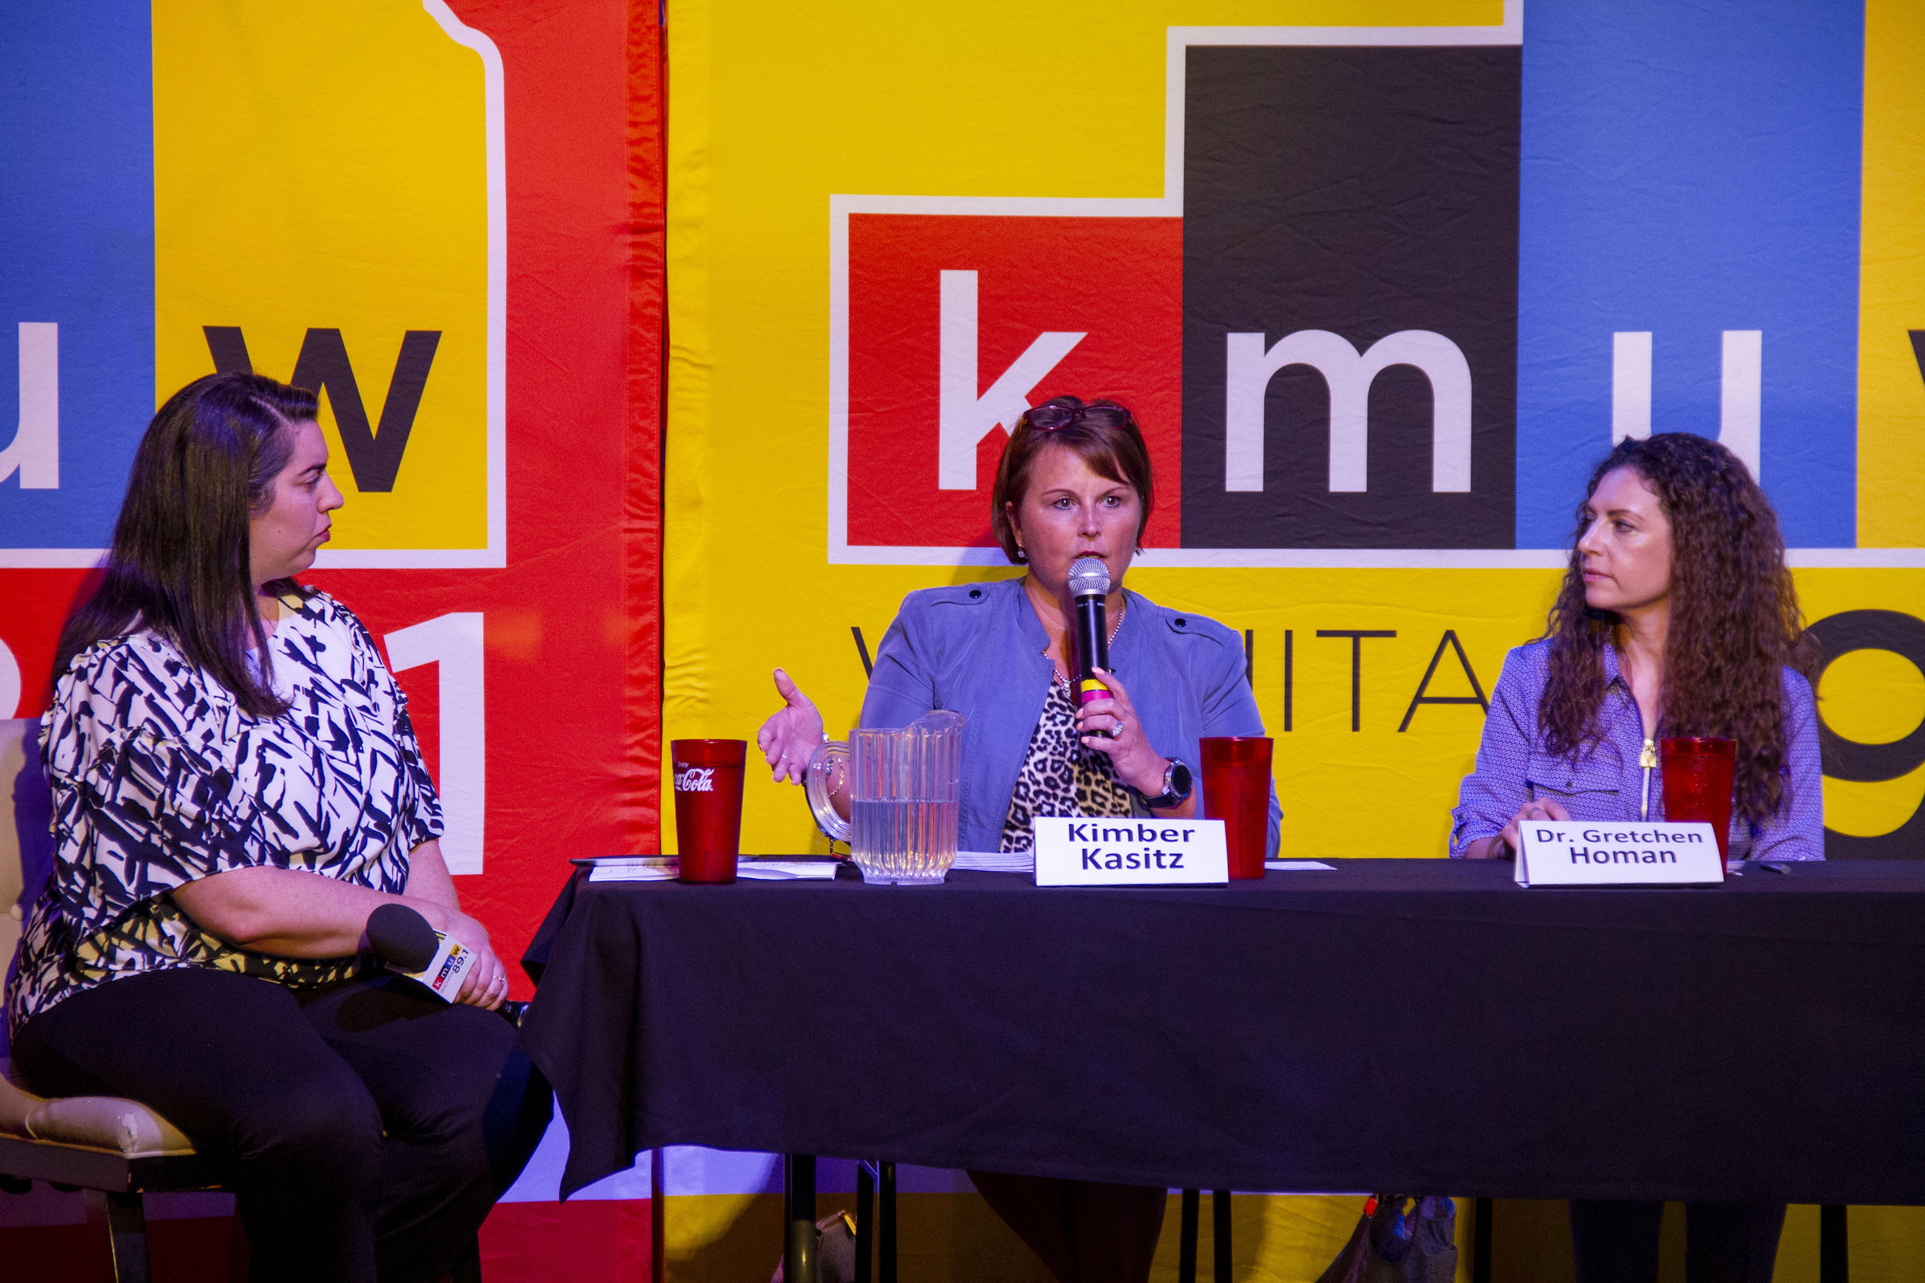
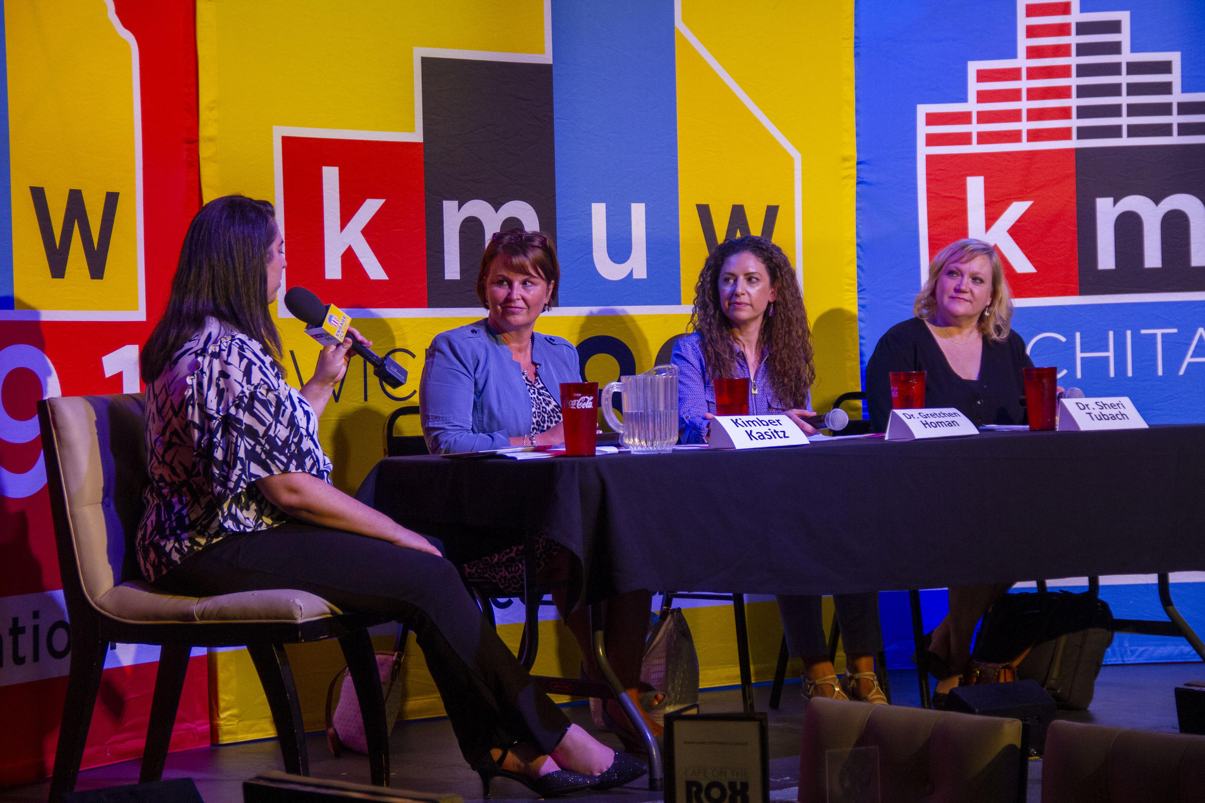
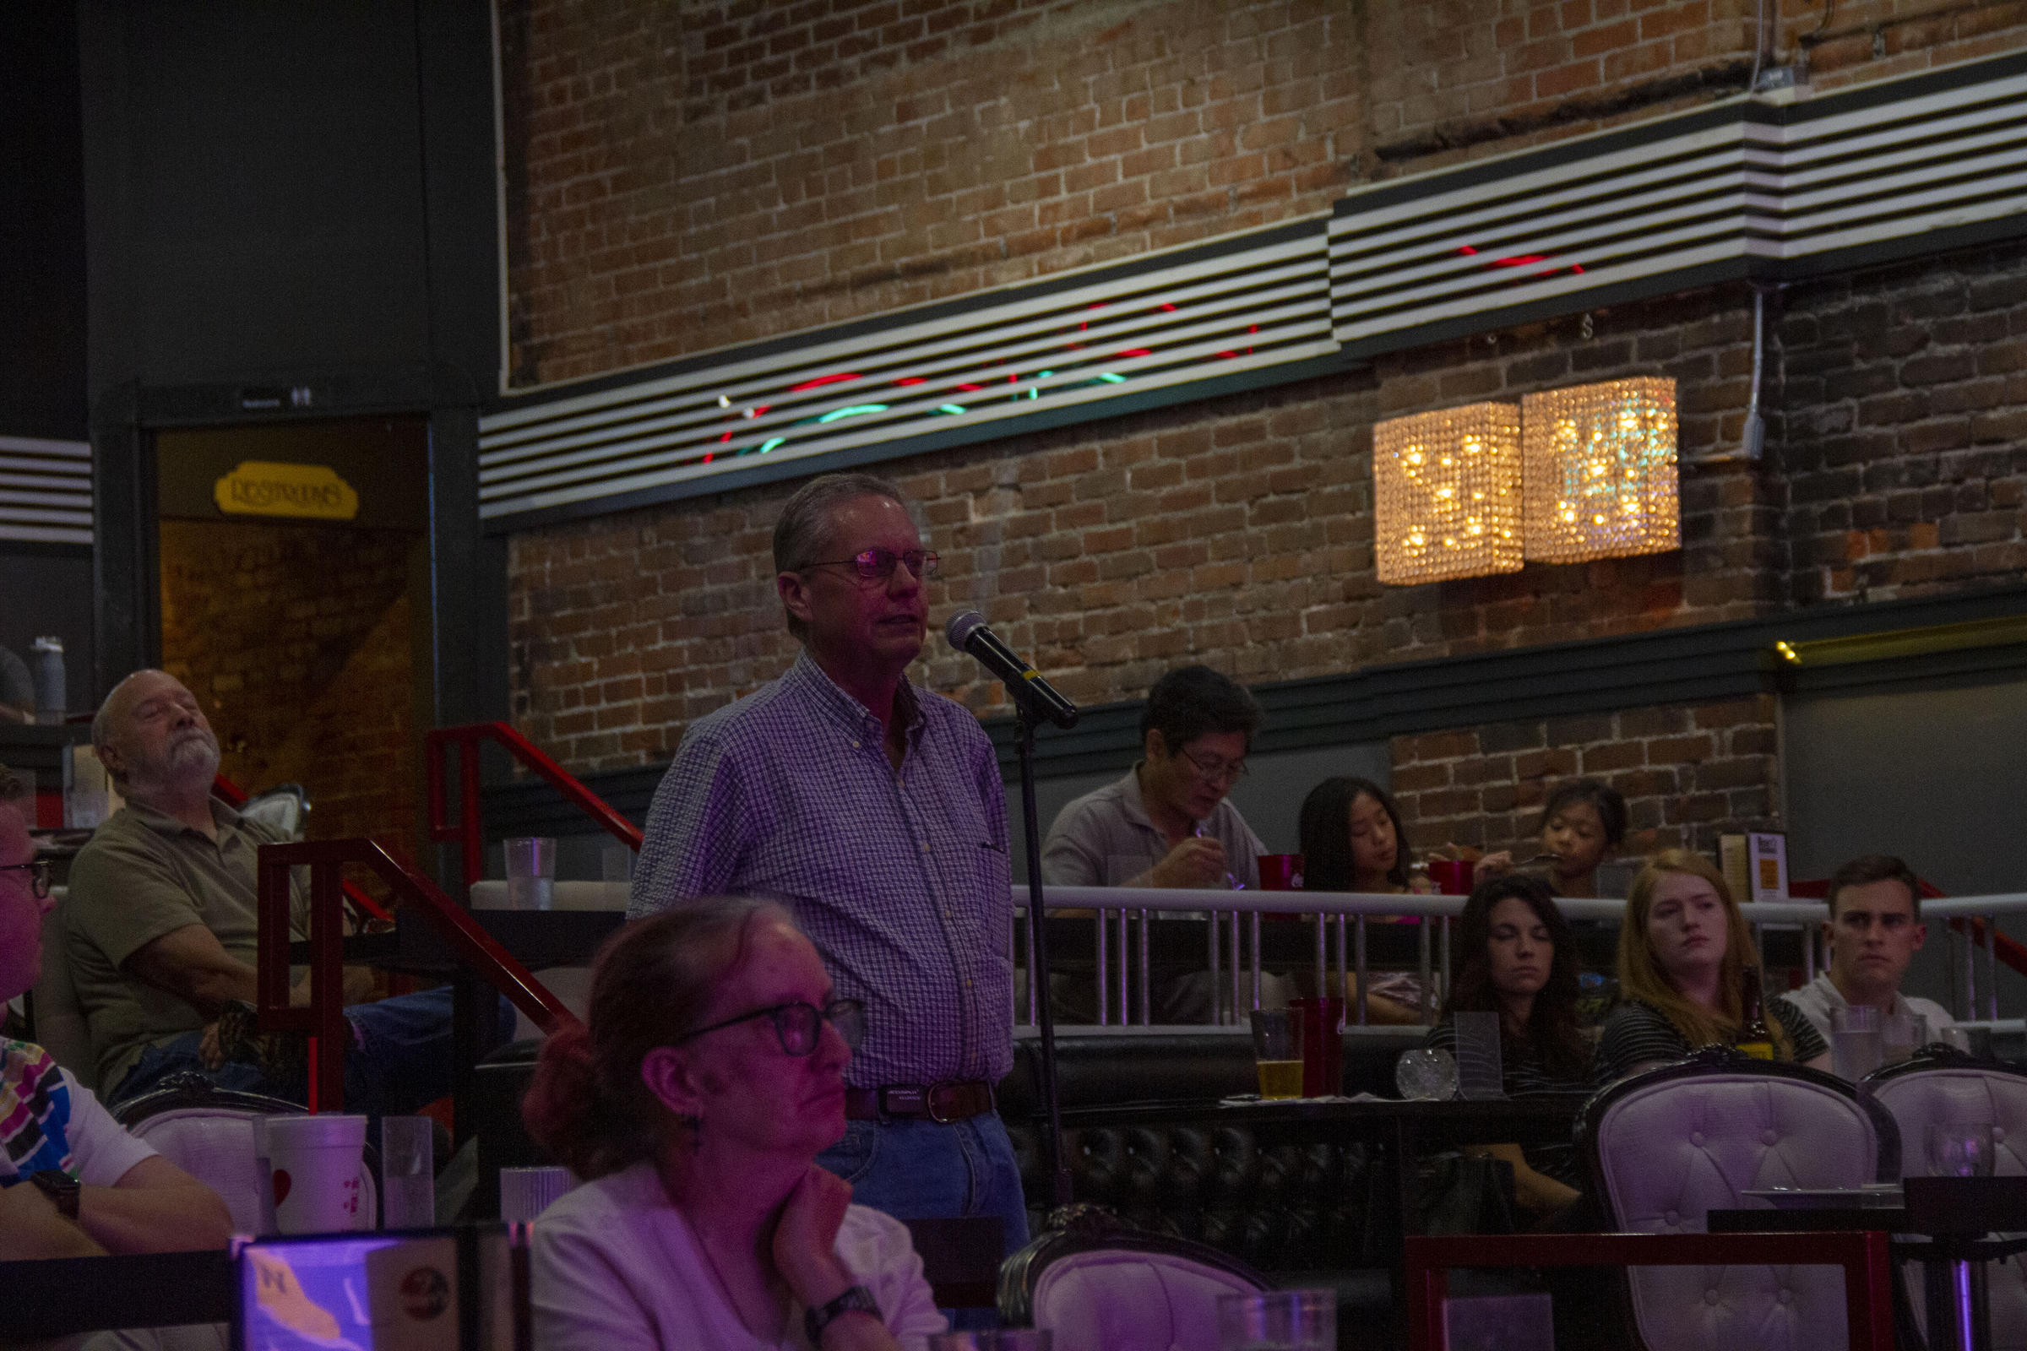
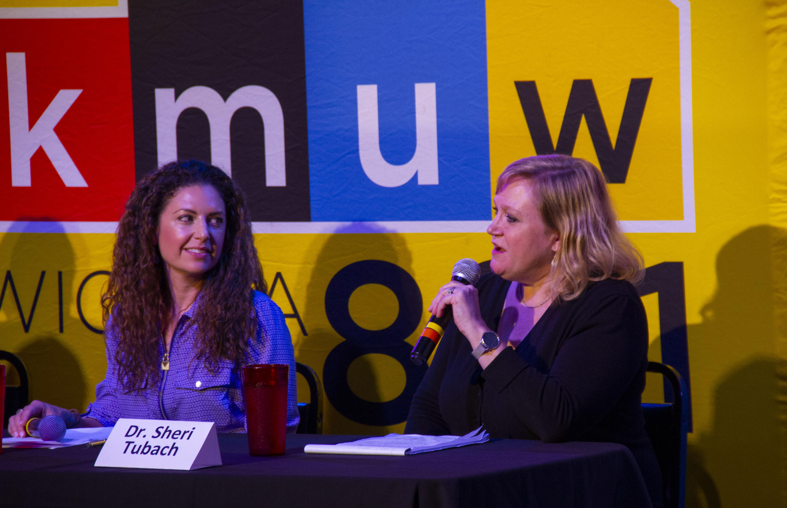
Notes:
https://www.kmuw.org/post/democracy-tap-vaccinations

Slide 11
August is National Immunization Awareness Month
Share IKC’s posts based on CDC’s toolkit on your social media!

Slide 12
Dr. Dennis Cooley was interviewed and Chelsea Rayburn provided a quote for a KSNT news story about vaccines.
July 30, 2019

Slide 13
Follow IKC on Twitter @ImmKSCoalition

Slide 14
Keep sharing the HPV Vaccine Videos! www.immunizekansascoalition.org

